Slide 1

DNN for time series- build the layer neural network
Notes:
‹#›

Slide 2
Objectives
Understand feeding windowed dataset into neural network
Implement the machine learned linear regression model of the time-series data
Build a single layer network and train it using the same synthetic data
Prepare time series data for training and evaluation
Measure the performance of your model against a validation set
build the layer neural network
‹#›

Slide 3
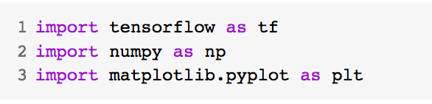
Feeding windowed dataset into neural network
Imports libs
Tensorflow to build your model and prepare data windows
Numpy for numerical processing
Matplotlib's PyPlot library for visualization
build the layer neural network
‹#›
Notes:
‹#›

Slide 4
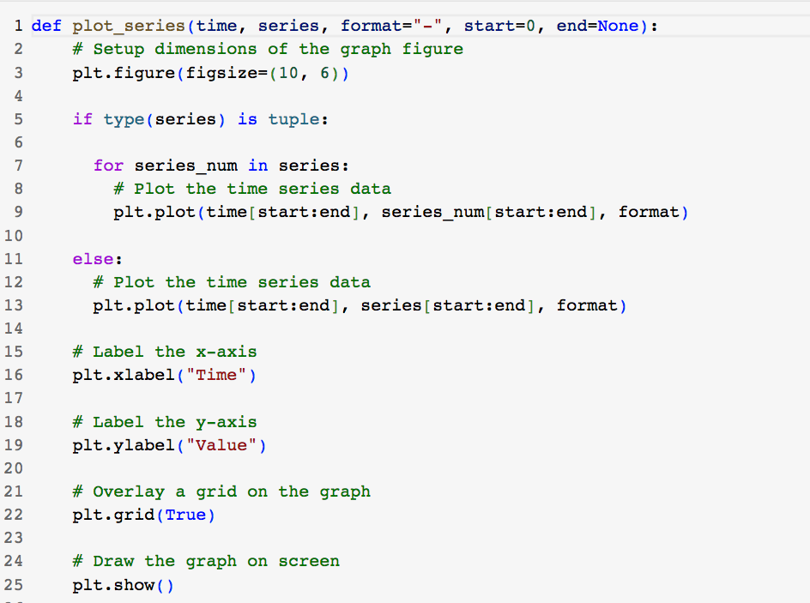
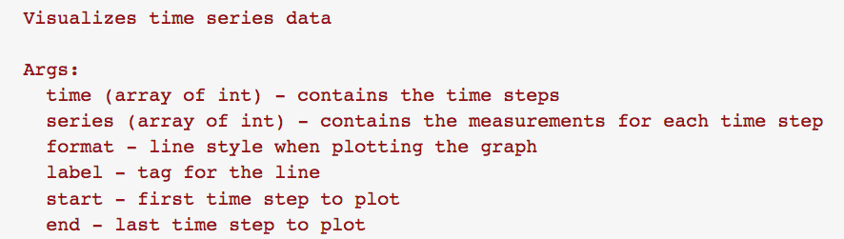
Feeding windowed dataset into neural network
Utilities
build the layer neural network
‹#›
Notes:
‹#›

Slide 5
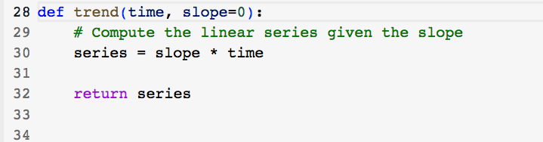
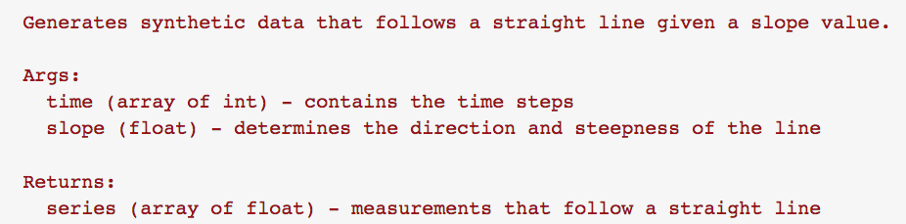
Feeding windowed dataset into neural network
Utilities
build the layer neural network
‹#›
Notes:
‹#›

Slide 6
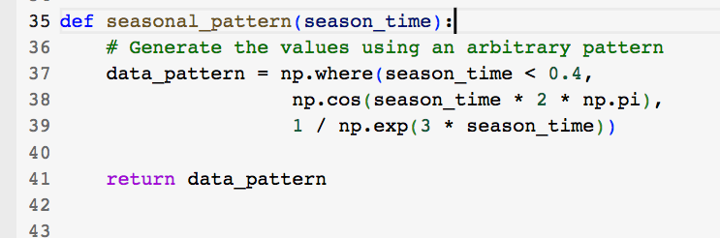
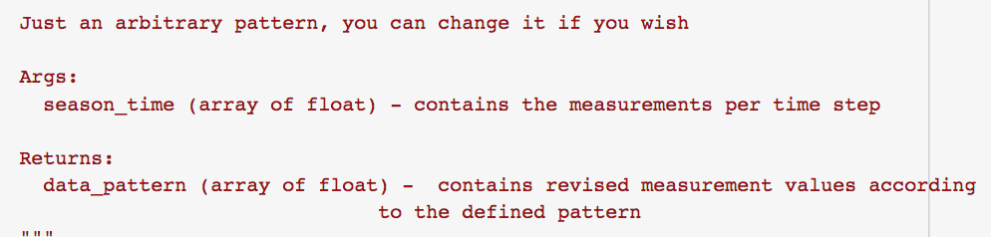
Feeding windowed dataset into neural network
Utilities
build the layer neural network
‹#›
Notes:
‹#›

Slide 7
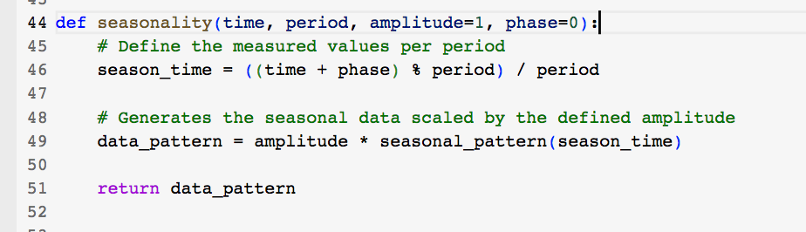
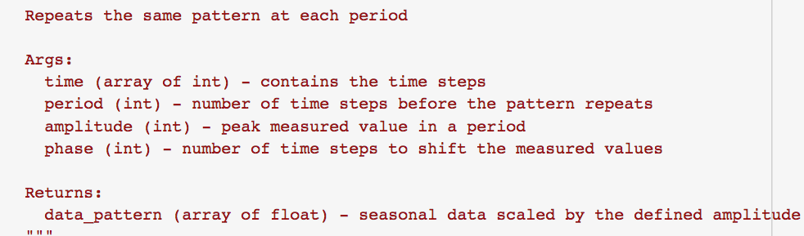
Feeding windowed dataset into neural network
Utilities
build the layer neural network
‹#›
Notes:
‹#›

Slide 8
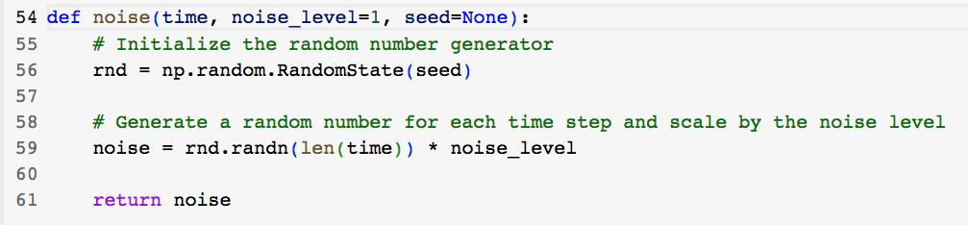
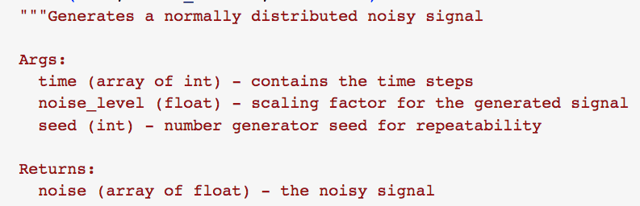
Feeding windowed dataset into neural network
Utilities
build the layer neural network
‹#›
Notes:
‹#›

Slide 9
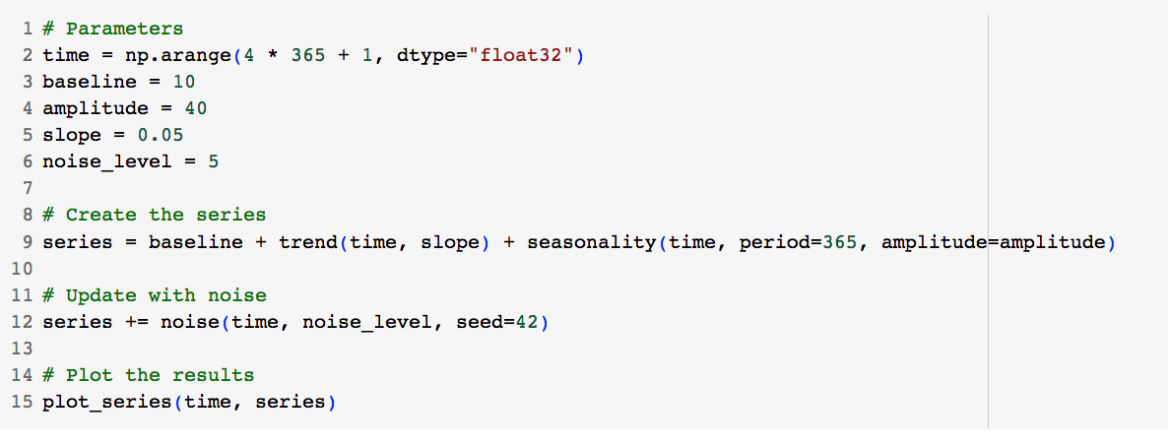
Feeding windowed dataset into neural network
Generate the Synthetic Data
build the layer neural network
‹#›
Notes:
‹#›

Slide 10
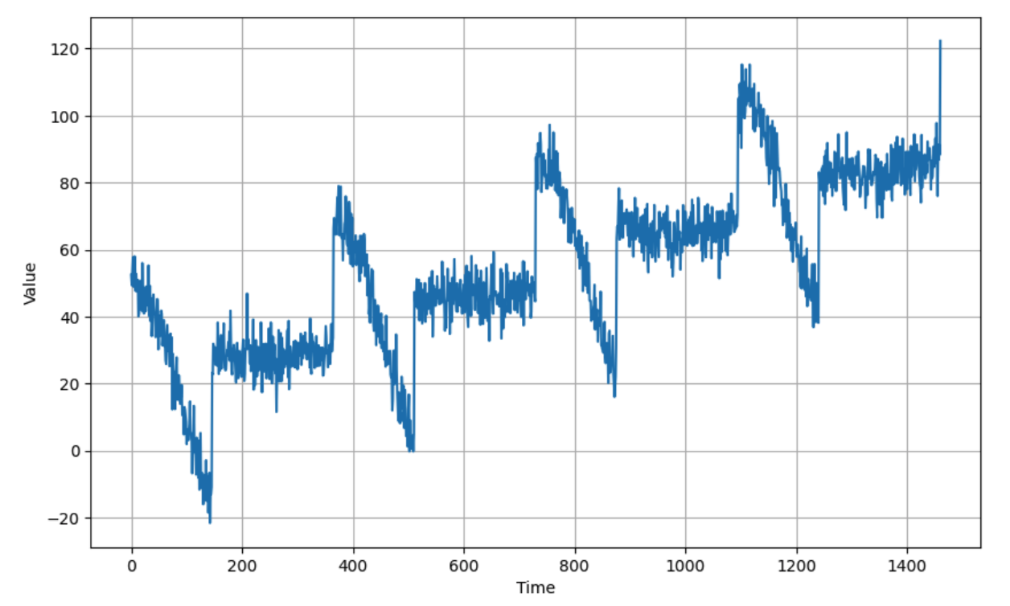
Feeding windowed dataset into neural network
Generate the Synthetic Data
build the layer neural network
‹#›
Notes:
‹#›

Slide 11
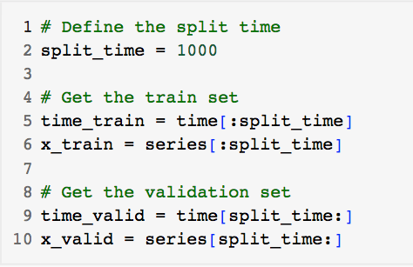
Feeding windowed dataset into neural network
Split the Dataset
build the layer neural network
‹#›
Notes:
‹#›

Slide 12
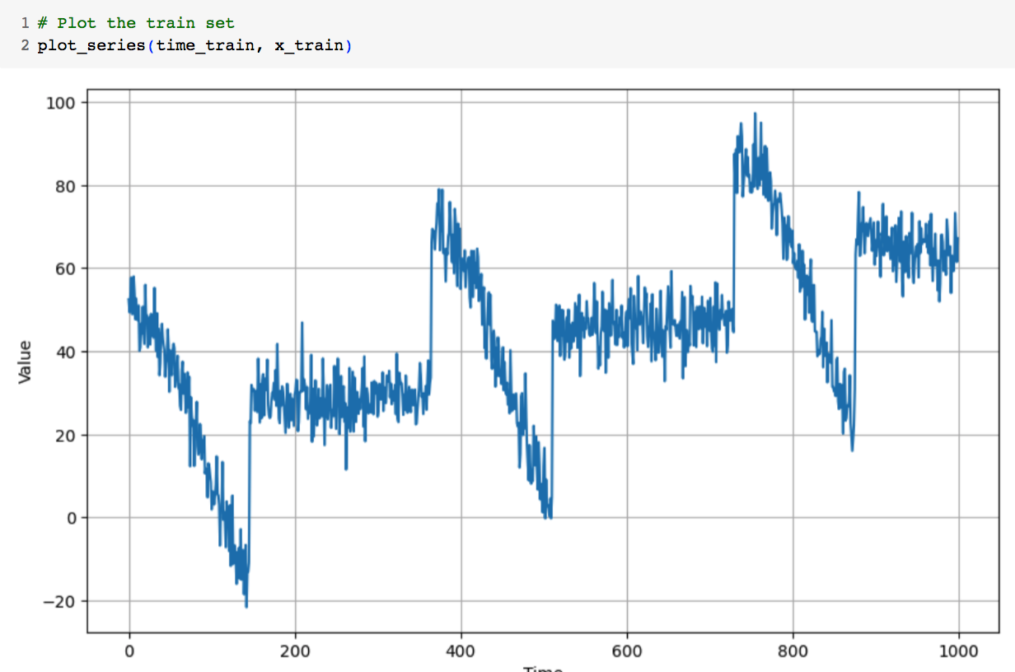
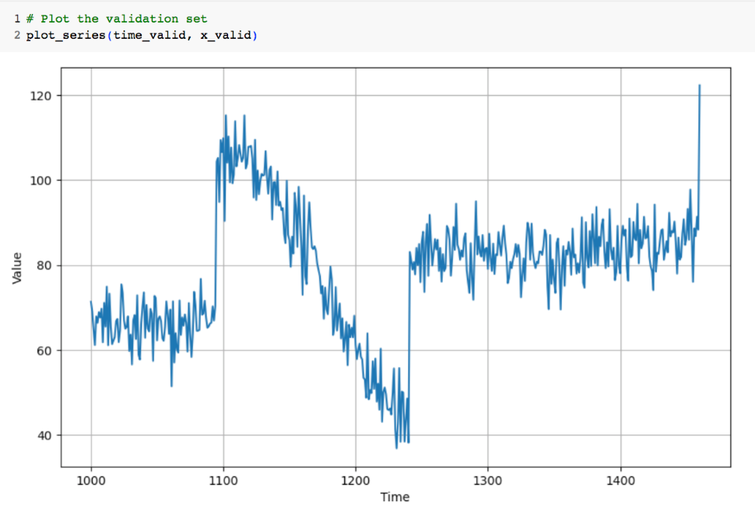
Feeding windowed dataset into neural network
Train and validation set
build the layer neural network
‹#›
Notes:
‹#›

Slide 13
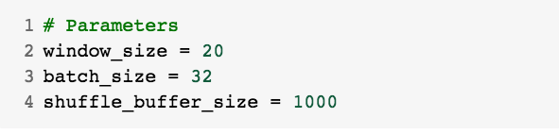
Feeding windowed dataset into neural network
Prepare features and labels
build the layer neural network
‹#›
Notes:
‹#›

Slide 14
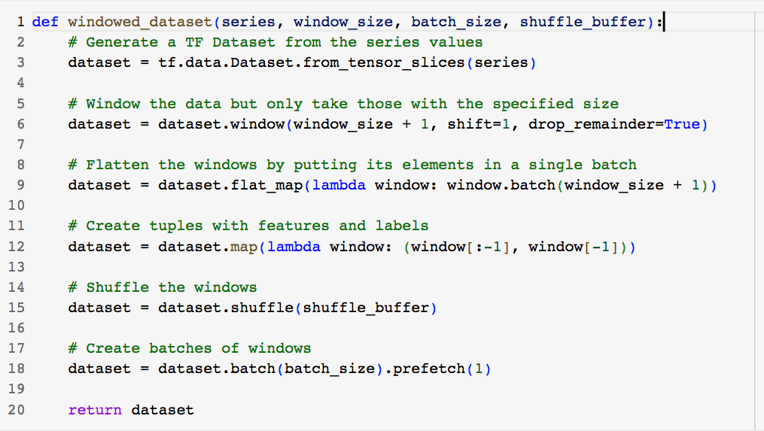
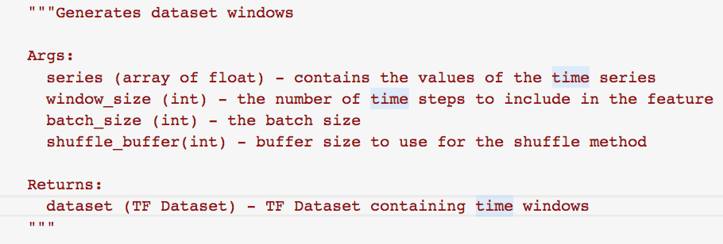
Feeding windowed dataset into neural network
Generates dataset windows
build the layer neural network
‹#›
Notes:
‹#›

Slide 15
Feeding windowed dataset into neural network
Generate the dataset windows from the train set.
build the layer neural network
‹#›
Notes:
‹#›

Slide 16
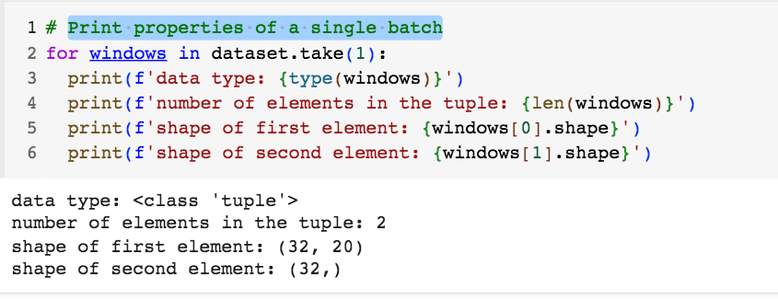
Feeding windowed dataset into neural network
Print properties of a single batch
build the layer neural network
‹#›
Notes:
‹#›

Slide 17
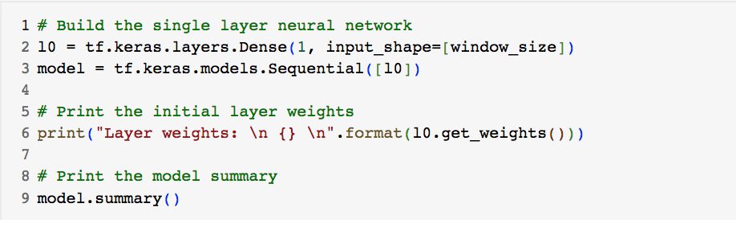
Feeding windowed dataset into neural network
Build and compile the model
build the layer neural network
‹#›
Notes:
‹#›

Slide 18

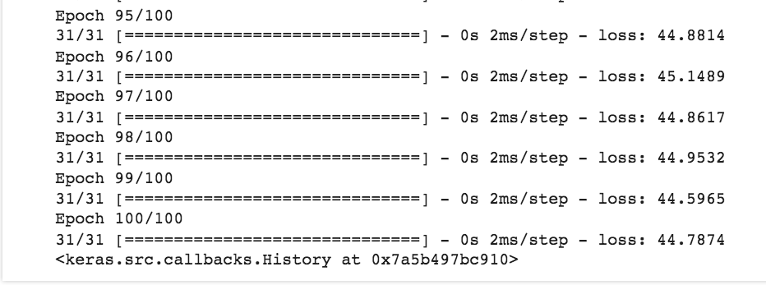
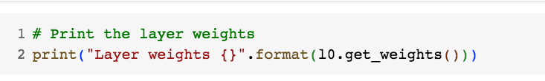
Feeding windowed dataset into neural network
Train the Model
The final weights
build the layer neural network
‹#›
Notes:
‹#›

Slide 19
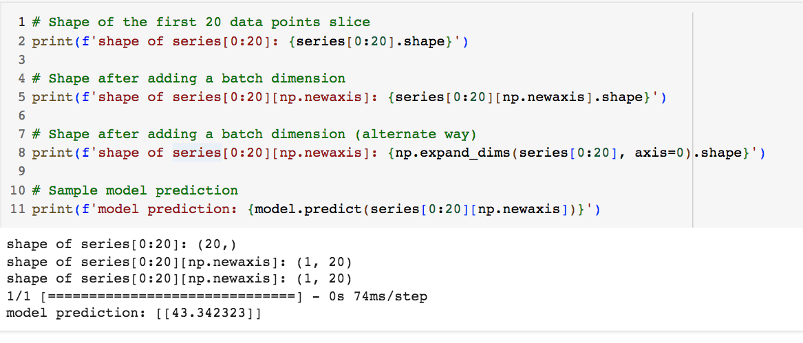
Feeding windowed dataset into neural network
Model Prediction
build the layer neural network
‹#›
Notes:
‹#›

Slide 20
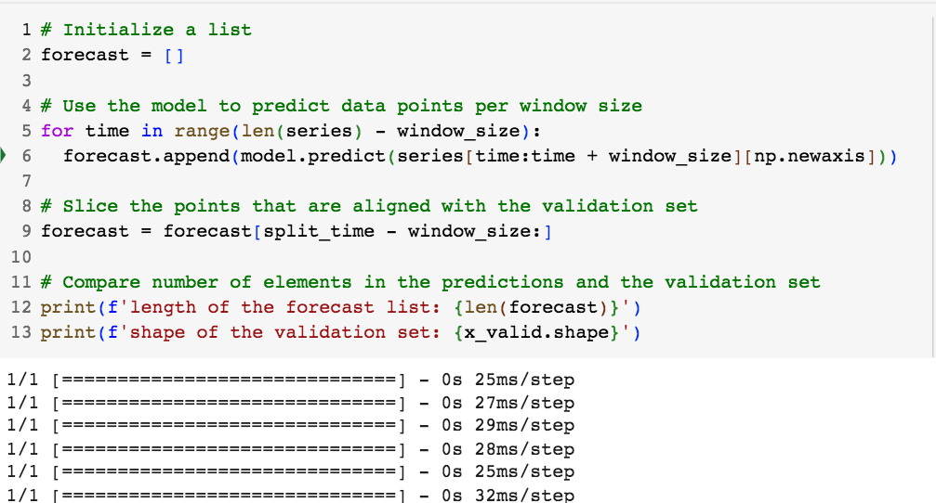
Feeding windowed dataset into neural network
Compute the metrics
build the layer neural network
‹#›
Notes:
‹#›

Slide 21
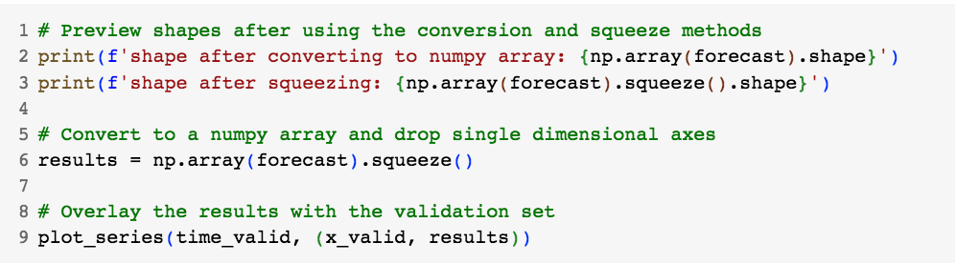
Feeding windowed dataset into neural network
Visualize the results
build the layer neural network
‹#›
Notes:
‹#›

Slide 22
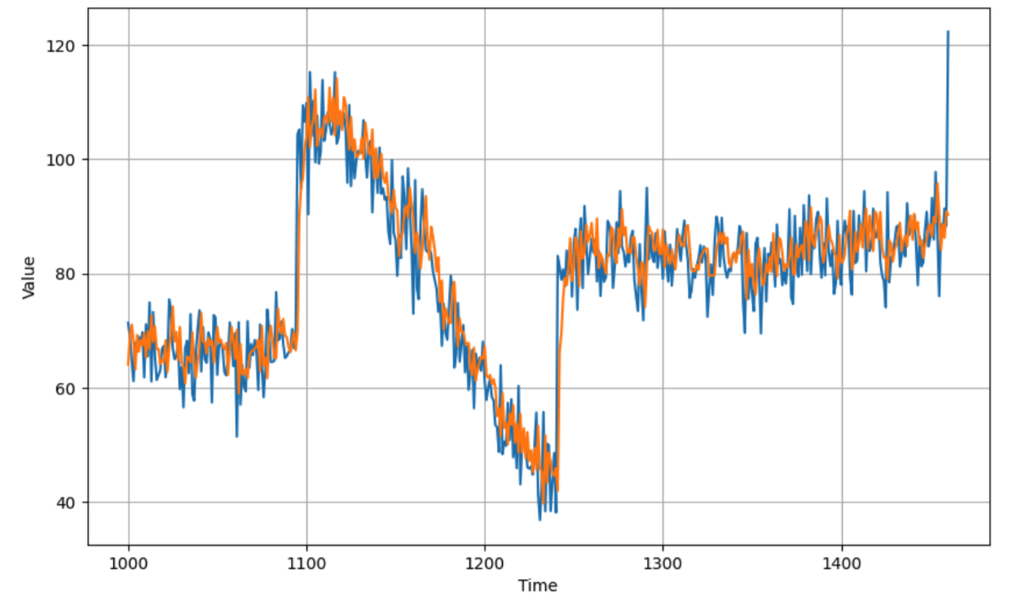
Feeding windowed dataset into neural network
Visualize the results
build the layer neural network
‹#›
Notes:
‹#›

Slide 23
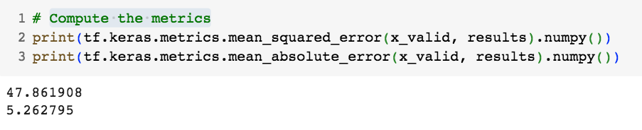
Feeding windowed dataset into neural network
Compute the metrics
build the layer neural network
‹#›
Notes:
‹#›

Slide 24
Feeding windowed dataset into neural network
Student discuss and give opinions about this prediction based on the model which has single layer
build the layer neural network
‹#›
Notes:
‹#›

Slide 25
Summary
Understand feeding windowed dataset into neural network
Implement the machine learned linear regression model of the time-series data
Build a single layer network and train it using the same synthetic data
Prepare time series data for training and evaluation
Measure the performance of your model against a validation set
build the layer neural network
‹#›

Slide 26
Q & A
build the layer neural network
‹#›

